Slide 1
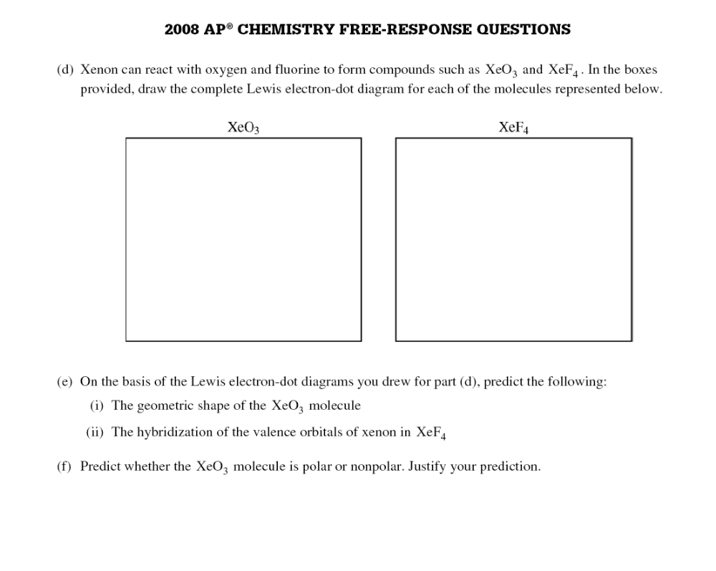

Slide 2
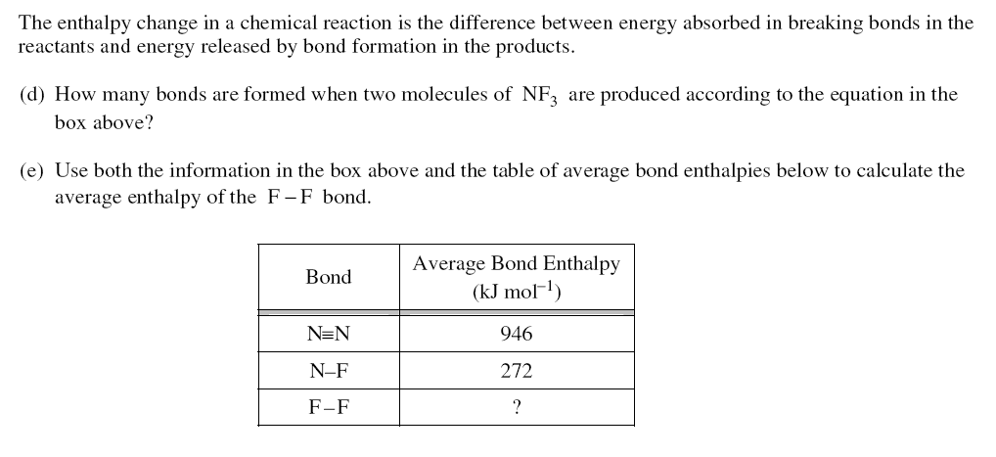

Slide 3
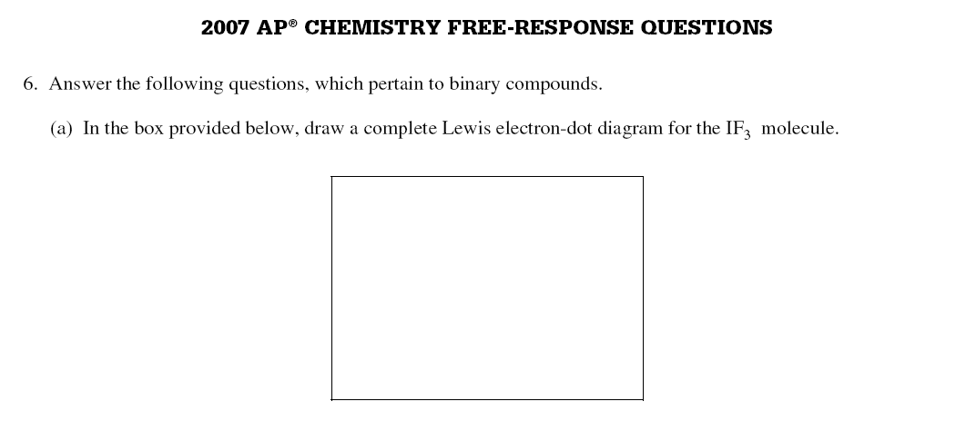
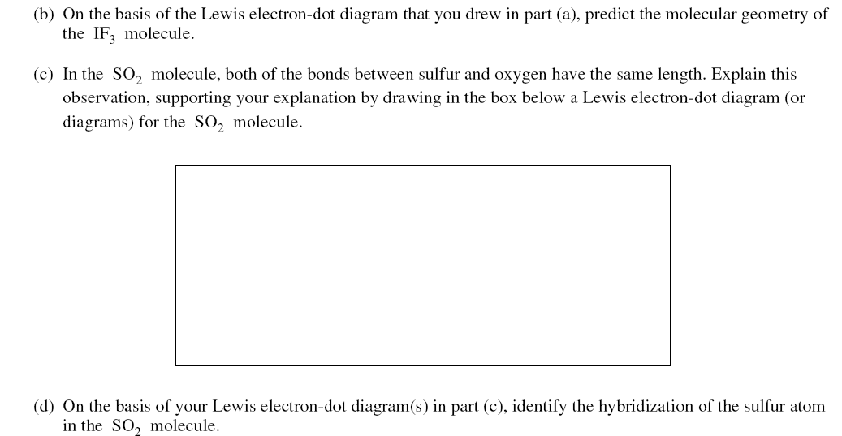

Slide 4
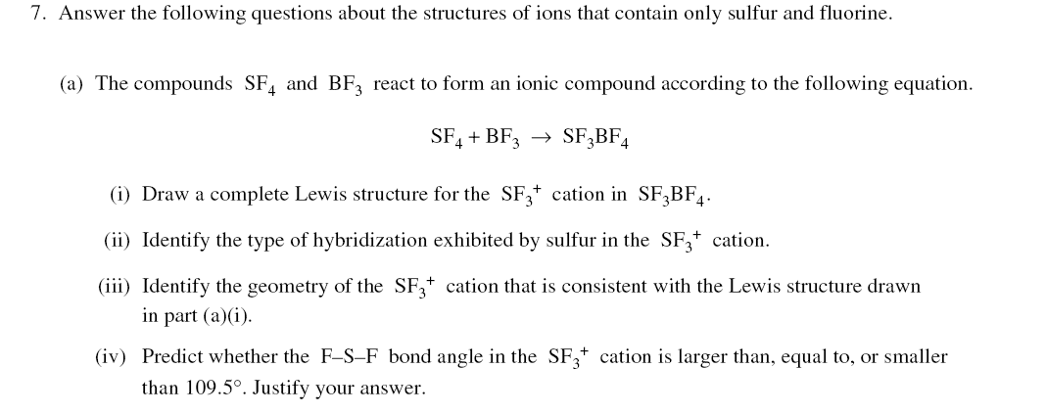
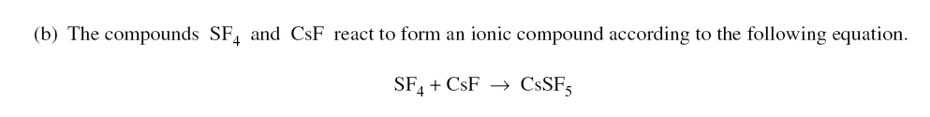
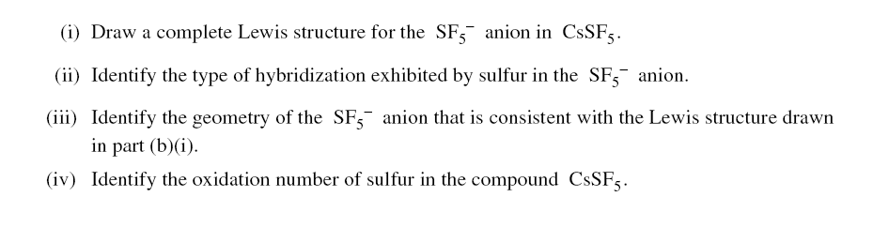

Slide 5
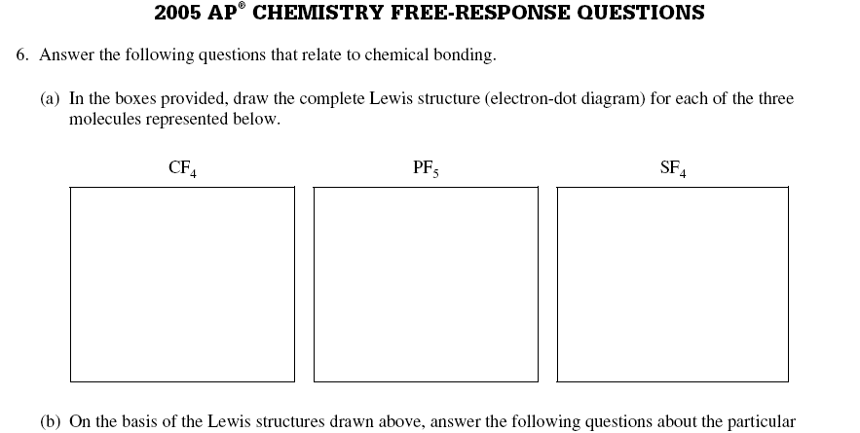
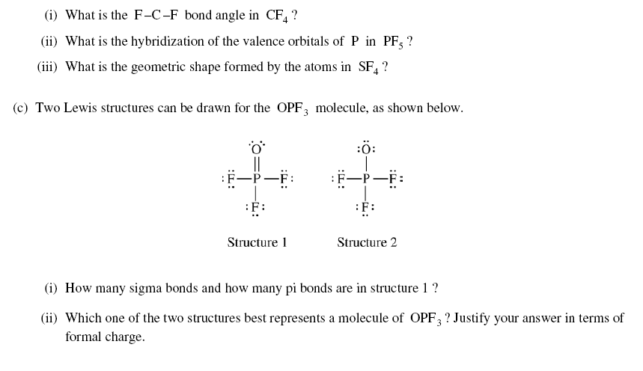

Slide 6
2003

Slide 7
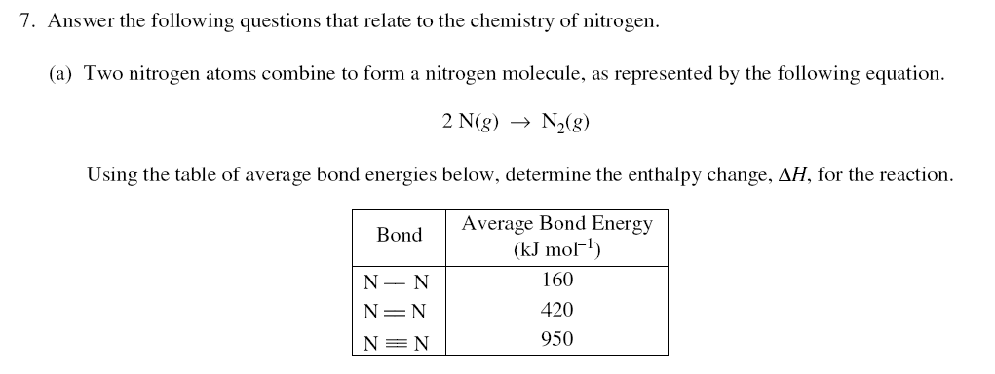
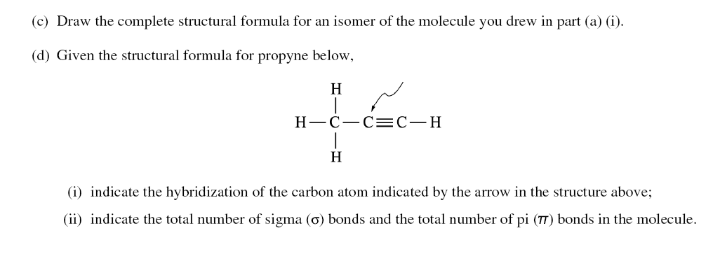

Slide 8
CO₂
H₂O
CH₄
C₂H₄
PH₃
The molecule with only one double bond.
The molecule with the largest dipole moment
The molecule that has trigonal pyramidal geometry

Slide 9
3)D
4)B
5)E

Slide 10
In which of the following groups are the three species isoelectronic?
S²⁻, K⁺, Ca²⁺
Sc, Ti, V²⁺
O²⁻, S²⁻, Cl⁻
Mg²⁺, Ca²⁺, Sr²⁺
Cs, Ba²⁺, La³⁺

Slide 11
A

Slide 12
Of the following compounds, which is the most ionic?
SiCl₄
BrCl
PCl₃
Cl₂O
CaCl₂

Slide 13
E

Slide 14
Which of the following oxides is gas at 25 degrees C?
Rb₂O
N₂O
Na₂O₂
SiO₂
La₂O₃

Slide 15
B

Slide 16
A pure, white crystalline solid dissolves in water to yield a basic solution that liberates a gas when excess acid is added to it. On the basis of this information, the solid could be
KNO₃
K₂CO₃
KOH
KHSO₄
KCL

Slide 17
B

Slide 18
Types of Hybridization exhibited by the C atoms in propene, CH₃CHCH₂ include which of the following?
sp II. sp² III. Sp³
I only
III only
I and II only
II and III only
I, II, and III

Slide 19
D

Slide 20
Of the following molecules, which has the largest dipole moment?
CO
CO₂
O₂
HF
F₂

Slide 21
D

Slide 22
The electron-dot structure (Lewis Structure) for which of the following molecules would have two unshared pairs of electrons on the central atom?
H₂S
NH₃
CH₄
HCN
CO₂

Slide 23
A

Slide 24
I₂(g) + 3Cl₂(g) → 2ICl₃(g)
According to the data in the table below, what is the value of DHº for the reaction represented above?
Bond Average Bond Energy kJ/mole
I – I 149
Cl – Cl 239
I – Cl 208
-860 kJ
-382 kJ
+180 kJ
+450 kJ
+1258 kJ

Slide 25
B

Slide 26
Which of the following molecules has a dipole moment of zero?
C₆H₆
NO
SO₂
NH₃
H₂S

Slide 27
A

Slide 28
Molecules that have planar configuration include which of the following?
BCl₃ II. CHCl₃ III. NCl₃
I only
III only
I and II only
II and III only
I, II and III only

Slide 29
A

Slide 30
The SbCl₅ molecule has a trigonal bipyramidal structure. Therefore the hybridization of Sb orbitals should be.
sp²
sp³
dsp²
dsp³
d²sp³

Slide 31
D

Slide 32
CCl₄, CO₂, PCl₅, PCl₃, SF₆
Which of the following does not describe any of the molecules above?
Linear
Octahedral
Square planar
Tetrahedral
Trigonal pyramidal

Slide 33
C

